Slide 1
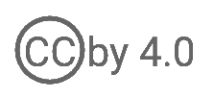
User Management
WSO2 Identity Server Fundamentals

Slide 2
Why User Management?
To securely and efficiently manage user identities
To define and manage access rights
To grant the necessary access rights to users based on their authority

Slide 3
Users and Attributes

Slide 4


User
The digital representation of a physical user who interacts with an application
HR
Application
Application User
[John Doe]

Slide 5

User Attributes
Data that defines the user, i.e., anything the user is, owned by, and associated with
First Name
!
!
Last Name
!
Date of Birth
!
Email
!
Country
!
Postal Code
Application User
[John Doe]

Slide 6
Permissions, Roles, and Groups

Slide 7





Permissions
The actions the users are authorized to perform
HR
Application
View Users
View Users
Edit Users
Application User
[John Doe]
Delete Users
Application Manager
[Jane Doe]
User Store 1

Slide 8

User Roles
A group of permissions that can be assigned to users depending on their job profile, e.g., manager
Developer Role
View Users
HR
Application
Application Developer
[John Doe]
Edit Users
Delete Users
Admin Role
User Store 1
Application Manager
[Jane Doe]

Slide 9
User Groups
Collection of users who have the same privileges to access resources
Managers Group
View Users
HR
Application
Application Manager
HR Manager
Edit Users
Delete Users
Team Lead
Director of HR
User Store 1

Slide 10
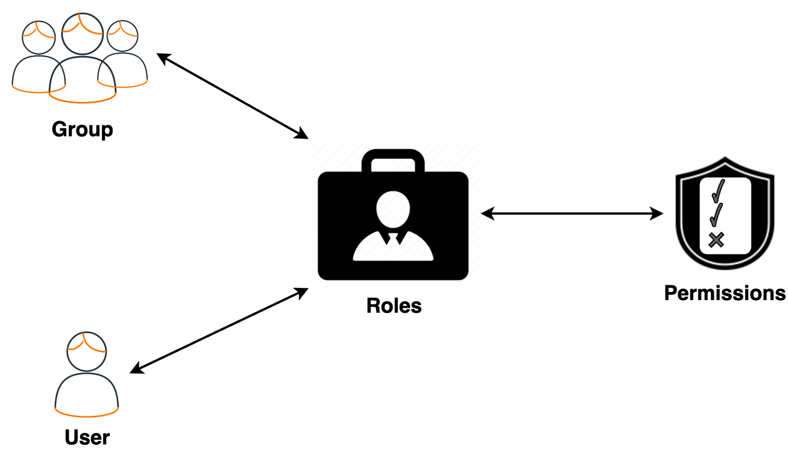
Group vs Role
Group
A collection of Users
Groups exists in user stores
A group can have users in the same user store
Role
A collection of rights/permissions
Roles can be assigned to groups/users
Roles assigned to a group will be transitively applied to all users in the group.

Slide 11
Users, Groups, Roles, and Permissions
Group
A user can belong to zero or many (multiple) groups.
A group can have zero or many (multiple) users.
Group-Role
A group can have zero or many (multiple) roles.
A role can be assigned to zero or many (multiple) groups.
Role
A user can have zero or many (multiple) roles.
A role can be assigned to zero or many (multiple) users.
Role-Permission
A role can have zero or many (multiple) permissions.
A permission can be assigned to zero or many (multiple) roles.

Slide 12
Users, Groups, Roles, and Permissions
Customer2 Role
View Users
Customer Role
Editor Group
Edit Users
Developer Role
Viewer Group
Delete Users
Admin Role

Slide 13
Role-Based Access Control (RBAC)
Resources are only accessible by the users assigned with particular user roles
Reduced administrative costs
Ability to efficiently grant/revoke access to/from users by assigning/unassigning user roles
Ability to reduce/increase permissions for multiple users at once by simply modifying the related user role
Easy to comply with regulations related to privacy

Slide 14
User Stores

Slide 15





User Stores
A repository that stores information on users and user roles
Users
Claims
User Groups
First Name
Developer
!
Primary User Store
Application User
[John Doe]
!
Admin
HR
Application
Last Name
Identity Provider (IdP)
Users
Claims
User Groups
First Name
Developer
!
!
Admin
Secondary User Store
Application User
[Jane Doe]
Last Name

Slide 16
Quick Recap

Slide 17

The need for user management
Overview of users, attributes, permissions, user roles, user groups and user stores
Role based access control
What you learnt

Slide 18



Any Questions ?
Reach us through the following channels
iam-dev@wso2.org
https://stackoverflow.com/questions/tagged/wso2-identity-server
https://discord.com/invite/Xa5VubmThw

Slide 19
Thank you!
Notes:
Acknowledge that it’s been a lot of changes within the team
Thank you for your taking onboard the feedback and being open to change.
A lot of work , a lot of learning, sometimes feeling twice the exhaustion
But also hopefully seeing what I see, which is: better ways of working, more innovation in our approach, more business acumen, more effective reactivity , more ahead of the game. Because that’s where marketing needs to be.
All this in a context where it’s also been a lot of changes for WSO2.
And from this standpoint I wanted to remind you of what Sanjiva said about you owning the culture

